Slide 1
Global issues
Soil – its worth conserving

Slide 2
Good soil contains the nutrients needed for the growth of plants. It is therefore vital in feeding the Earth's growing population. But about 43 per cent of the Earth's dry land is desert or desert-like and useless for growing crops. In Australia the situation is much worse, with 96 per cent of Australian soil unsuitable for growing crops. That's what makes the rest of the soil such a valuable renewable resource.

Slide 3
Weathering and erosion
Rocks on the surface of the Earth are slowly and continuously being changed by natural events. They are broken down into smaller rocks in a process called weathering.
The action of the sea breaks off pieces of coastal rock, often leaving spectacular features such as rock platforms and the Twelve Apostles at Port Campbell National Park, Victoria.
The wind wears rock away, especially in dry conditions when it blasts the rock with sand and soil it has picked up.
Water on the ground can react with certain chemicals in rocks, soil and decaying plants, producing other chemicals that make the rocks crack and crumble more easily.

Slide 4
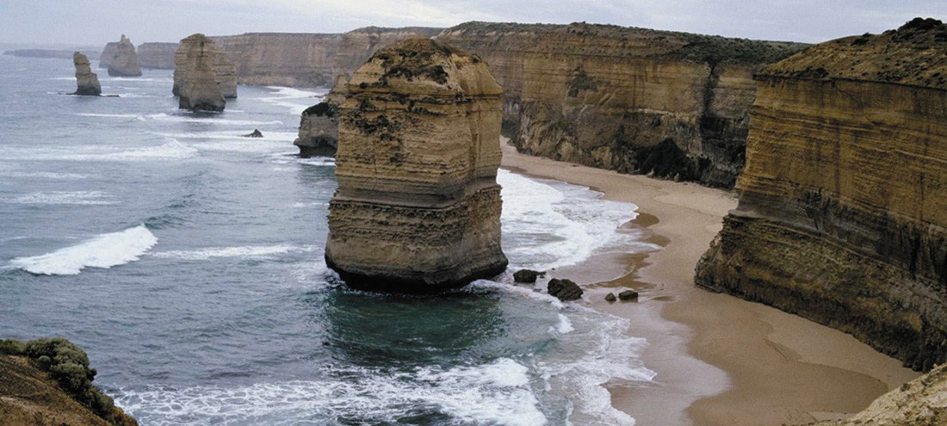

Slide 5
CARRIED AWAY
Weathered rock is usually moved from one place to another by the wind, running water, the sea or glaciers. This process is called erosion. The weathered rock moved by erosion is deposited, and settles on the land, riverbeds and floors of lakes, seas and oceans to form sediments. Deposits of dead plants and animal remains are also called sediments.
Soil is formed by weathering, erosion and deposition of rock. Soil also contains humus — decaying plant and animal material that plants can grow in.
Deposition of sand by the wind forms sand dunes, especially in coastal areas where sand is picked up and blown inland until it is stopped by obstacles like rocks or vegetation.

Slide 6
A fast-moving river is likely to carry with it sand, gravel and smaller particles. As it slows down on its path to the sea, it loses energy and particles are deposited, forming sediments. The larger particles, such as gravel and sand, settle first. By the time the river reaches the sea, it is usually travelling so slowly that the very fine mud particles begin to settle.
During floods, when rivers break their banks, sediments are deposited on flat open land beside the river. These plains are called floodplains.
The water in fast-moving rivers, along with the weathered rock it takes with it, can carve out deep valleys in the Earth's surface. One of the most252 spectacular examples of this is the Grand Canyon in Arizona, USA.

Slide 7
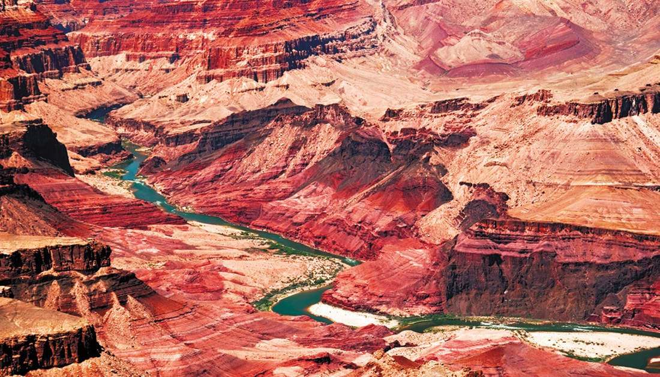

Slide 8
Why save the trees?
The roots of trees help to hold the soil together. Removing trees exposes good, fertile soil to wind and water. The soil is blown or washed away, leaving the land destroyed. Early Australian settlers originally cut down trees to create farmland. The removal of trees on a large scale is known as deforestation. As the population grew, more trees were cleared to provide space for industrial areas and housing. Since then, industrial areas have grown larger and the forests smaller. Trees are still being cleared for wood and wood products such as paper (see photo below).
Over the past 200 years, over two-thirds of Australian forests have been cleared.

Slide 9
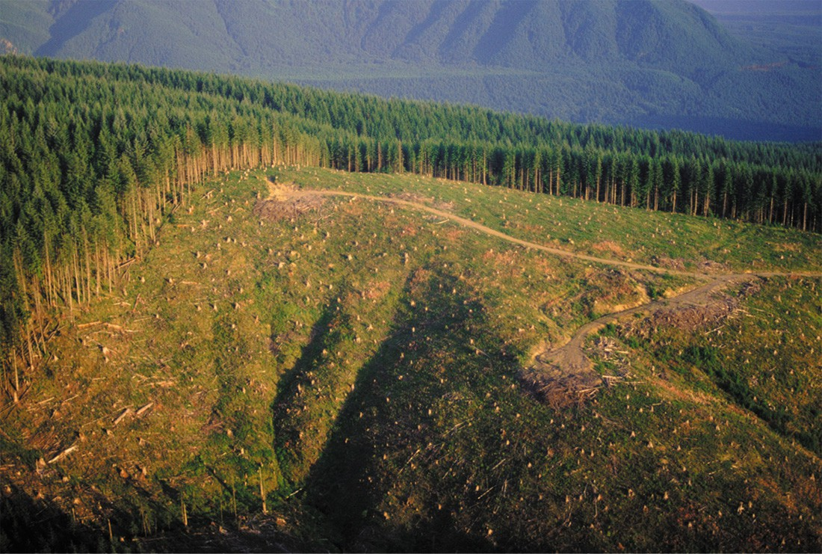

Slide 10
On the mend
Scientists, conservation groups and government bodies play an important part in improving the environment. The aim is to reduce the impact of human activity and repair past damage. Some methods for reducing erosion254 and repairing the damage already caused by erosion include:
farmers ploughing their fields around hills rather than up and down the slope. This reduces the amount of soil washed down hills by rain.
sealing roads and gutters to direct water into proper drains
controlling numbers of livestock to prevent overgazing
replacing trees that have been removed
fencing off large sections of beaches and banning recreational vehicles in many coastal areas
reducing the impact of introduced animals, such as rabbits, on native vegetation.

Slide 11
Acid rain
Every day many harmful chemicals are pumped into the air. Some are naturally formed chemicals, but many are from cars, factories or from other human activity. The chemicals in the air can dissolve in water, much like salt in hot water. The dissolved chemicals return to the ground in rainwater, snow or fog, and the combination is called acid rain.
Acid rain can poison trees, soil and water supplies. It even eats away at rocks, including those used in buildings and statues.

Slide 12
