Slide 1

A friend is coming over to play video games. He has never been to your house before. How do you let him know where you live?

Slide 2
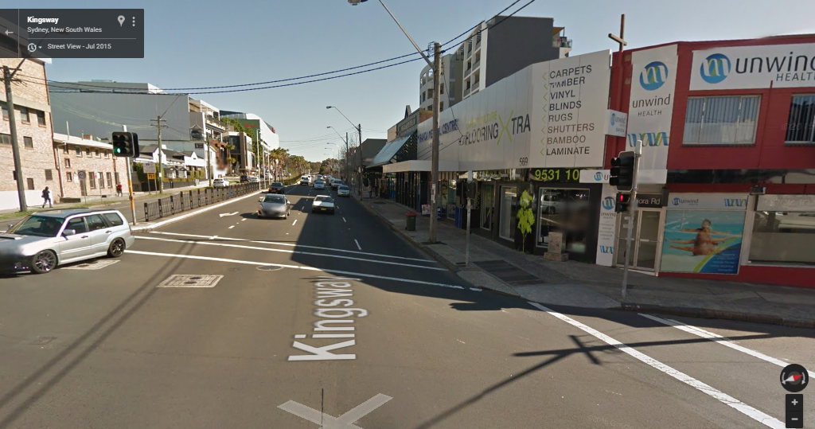
How would you let you friend know they had to meet you here?

Slide 3
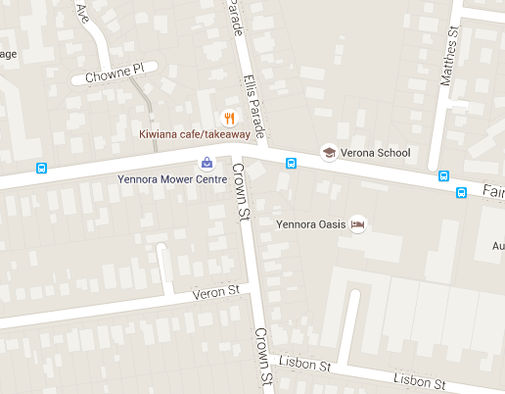
You need to meet your friend where the blue dot is on the map. How do you let them where to meet you?

Slide 4
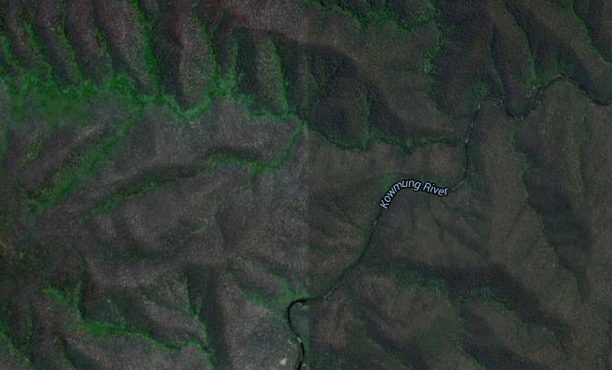
How would you let people know you are at the blue dot?

Slide 5
Area References:
Area references give us an area where some thing is located, but not a specific point.

Slide 7
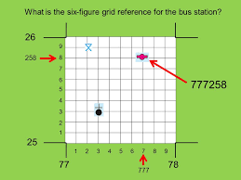
Grid Reference
Grid references are like area references, except they give us a specific point on a map. They are given be using a system of 6 numbers or figures.

Slide 8
6 Figure Grid References
L E N
Bottom left hand corner
Easting's first (Vertical lines)
Northing’s second (Horizontal lines)

Slide 9
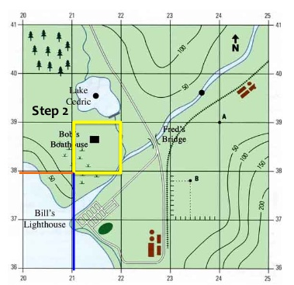
6 Figure grid reference

