Slide 1
Advertising Film
what makes you go to watch a movie?

Slide 2
What makes you go to see a Movie?
As a class brainstorm these ideas. You should be able to make connections to the reason why you go to the cinemas and pay to watch a movie.

Slide 3
Movie Posters
Do they have a Purpose?

Slide 6
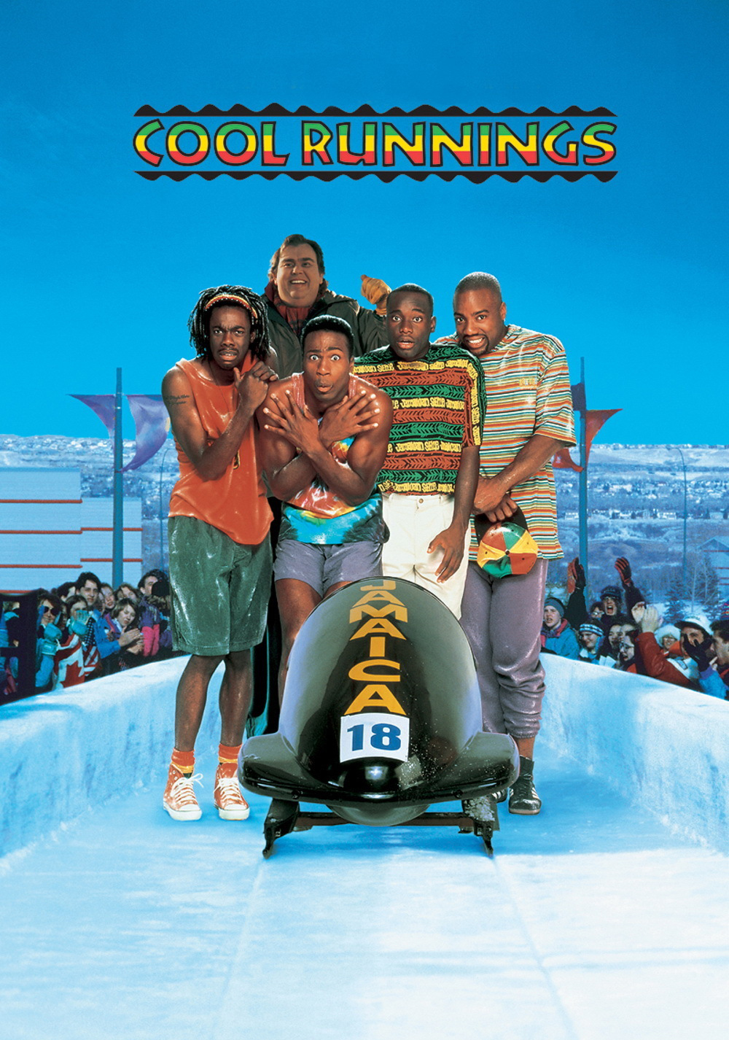

Slide 10
How Much do Movie Posters tell us?
Activity: As a class group you are to read all the movie blurbs and match them up with the movie poster you thing is correct.

Slide 11
Compare and contrast statement
The poster for _____________________ and the poster for ___________________
are similar because _________________________________________________ _____
________________________________________________________________________
________________________________________________________________________
________________________________________________________________________
However, they are different because _________________________________________
________________________________________________________________________
________________________________________________________________________
________________________________________________________________________

