Slide 1
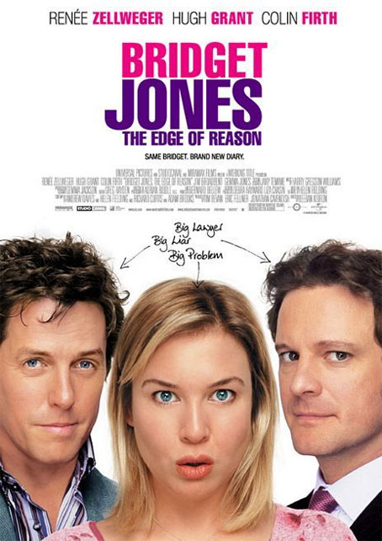
What makes people watch certain movies?
How do you know whether you will like it or not?

Slide 2
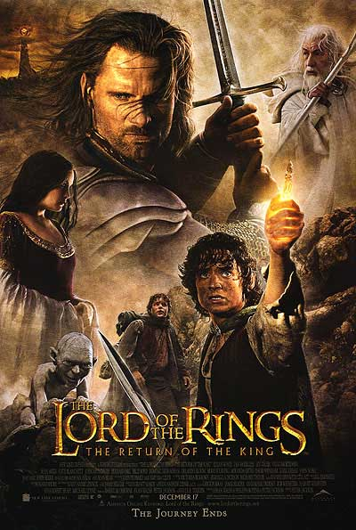
Some things that tell us if we might like a movie
The genre
Movie trailers
Advertising
Social Media
Word of mouth
Film reviews
The actors in the movie
Lets create a mind map of movie genres!

Slide 3
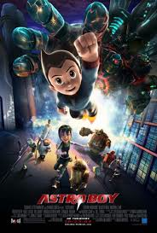
Watch these movie trailers and decided if you would like to see them. Why would you like to see them?

