Slide 1
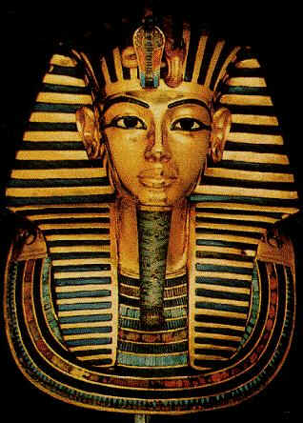
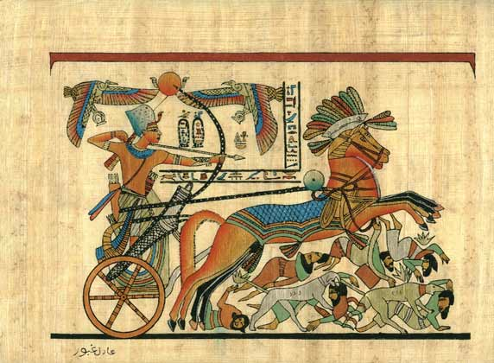
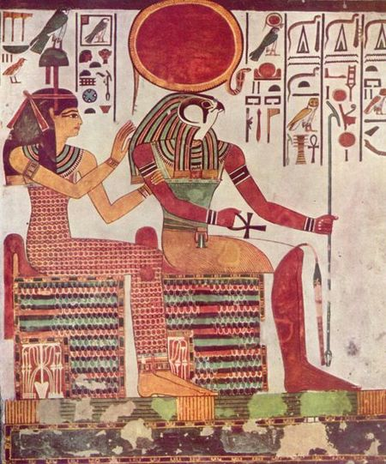
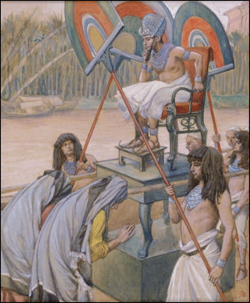
Ancient Egypt: the Pharaoh
Create a mind map about what these images tell us about the Pharaoh.
Look at our mind map: Who was the Pharaoh? What was his role in Ancient Egypt?

Slide 2
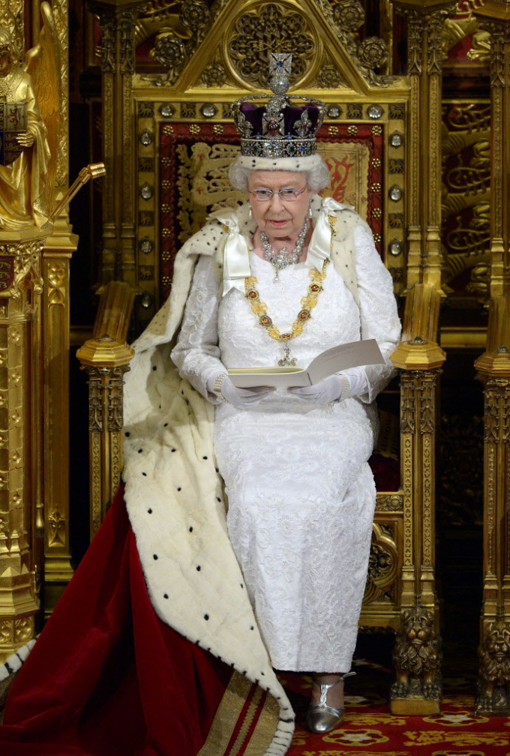
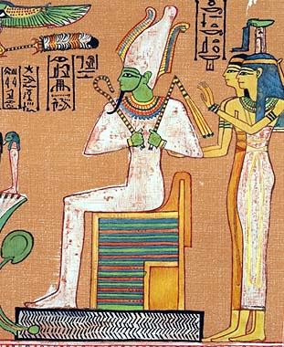
Ancient Egypt: the Pharaoh
Queen Elizabeth 2nd An Egyptian Pharaoh
1) Look at both pictures make a Venn diagram of how they are similar and different.
2) Write a passage compare and contrasting the two pictures.

Slide 3
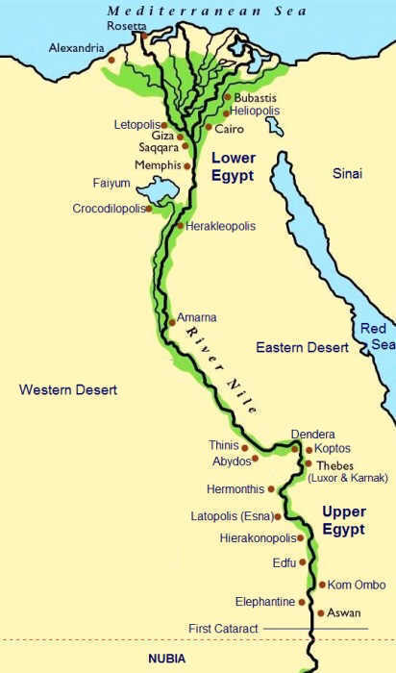
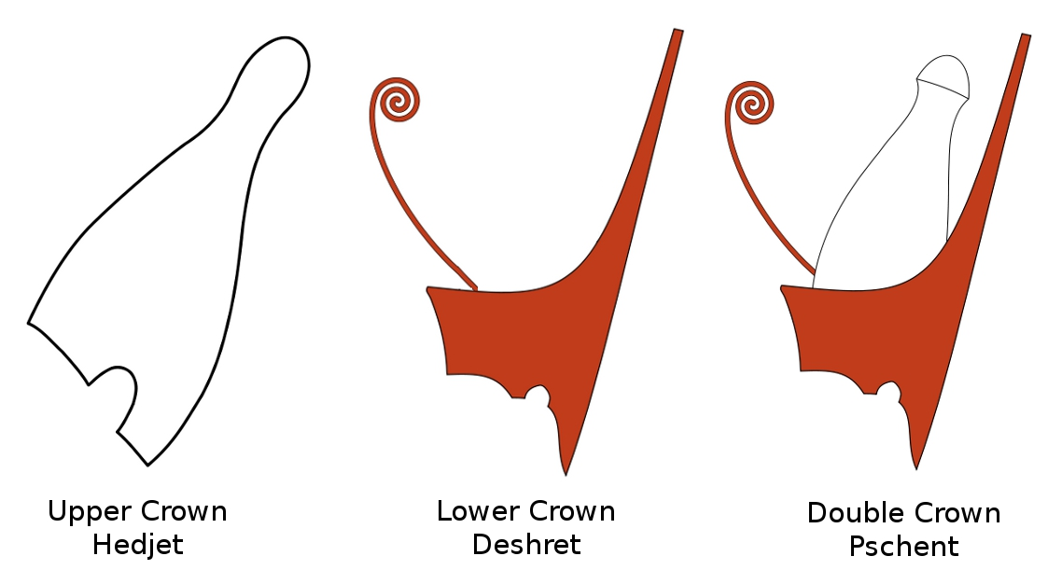
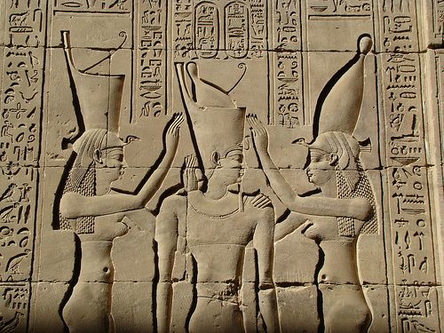
Ancient Egypt: the Pharaoh
As a class read the text on the Egyptian Pharaohs and then answer the questions.

Slide 4
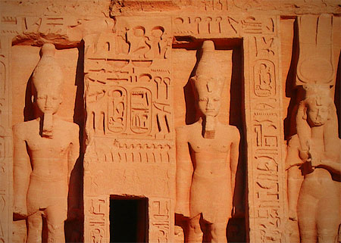
Ancient Egypt: the Pharaoh
To finish: Write a short list of 3 things you learnt about the Pharaohs of ancient Egypt.

