Slide 1
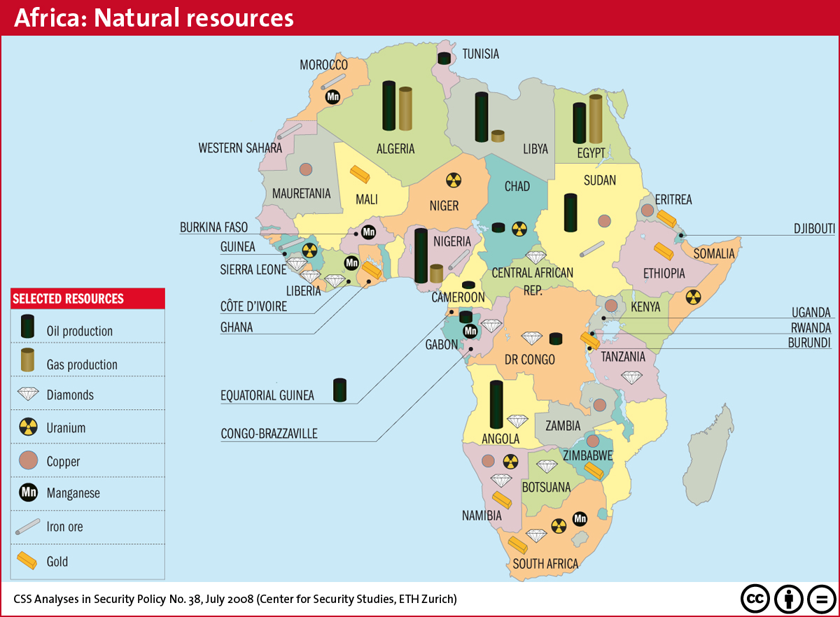
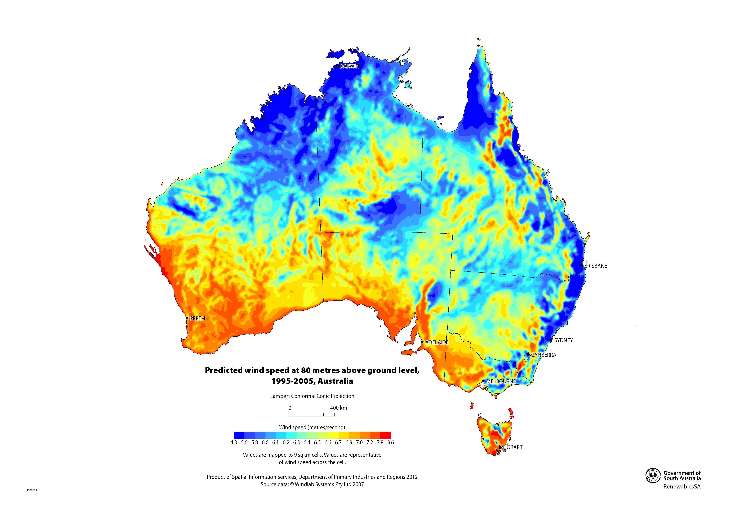
Types of maps
Resource maps: Show where resources are located. These might be where minerals, such as iron, coal, goal and oil are located or the locations of other resources such as water or soil type.
Geologists, mining companies, governments etc.

Slide 2
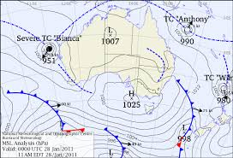
Types of maps
Weather maps: Show the weather pattern in an area, at a particular moment in time. Weather maps are used to forecast future weather conditions.
Meteorologists, pilots, soldiers, sailors, outdoor sports people etc.

Slide 3
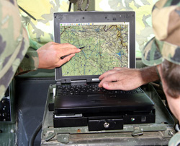
Types of maps
Global Positioning Systems (GPS): Are electronic maps that use satellites in space to work out your position on earth. They can do the functions of all the maps already discussed. GOOGLE MAPS is an example of a mapping system that uses GPS.

Slide 4
Mental Maps
Think about how you got to school today. Can you describe how you got to school?
In Geography what you know about an area is called your mental map. You use mental maps to do simple things such as move around your house to more complex thing such as getting around your local area or city.

Slide 5
Mapping my world
Task:
Make a list of all the places you go to include your house, friends places, shops, sporting fields or any place that you go to on a regular basis.
Using your list and the mental map you carry in your head, create a map of your world. Don’t worry it doesn’t have to be perfect, just make it bright and colourful.
Make sure you label your map.

