Slide 1
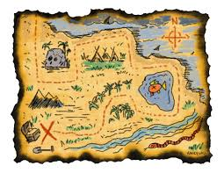
What is a map?????

Slide 2
Maps

Slide 3
What types of maps do you know? Who uses different types of maps?

Slide 4
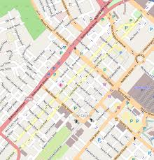
Types of maps
Street maps: Show the locations of streets and roads in an area. These maps also show important locations such as parks, hospitals, schools and police stations.
Tourists, delivery drivers, taxi drivers, police etc.

Slide 5
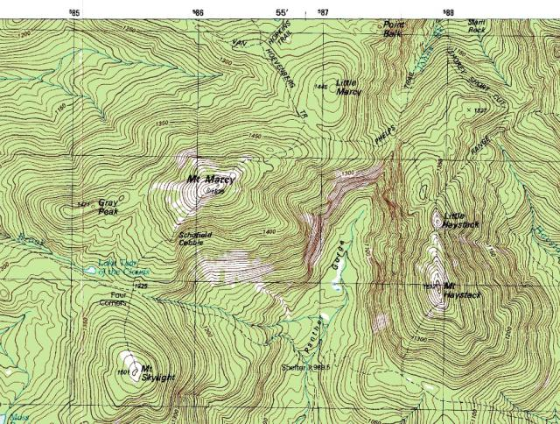
Types of maps
Topographic maps: Show the shape of the land such as hills and mountains and how steep they are. They also show rivers and streams, cliffs and the type of vegetation in the area.
Hikers, soldiers, geographers, pilots, geologists etc.

Slide 6
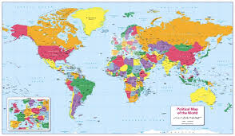
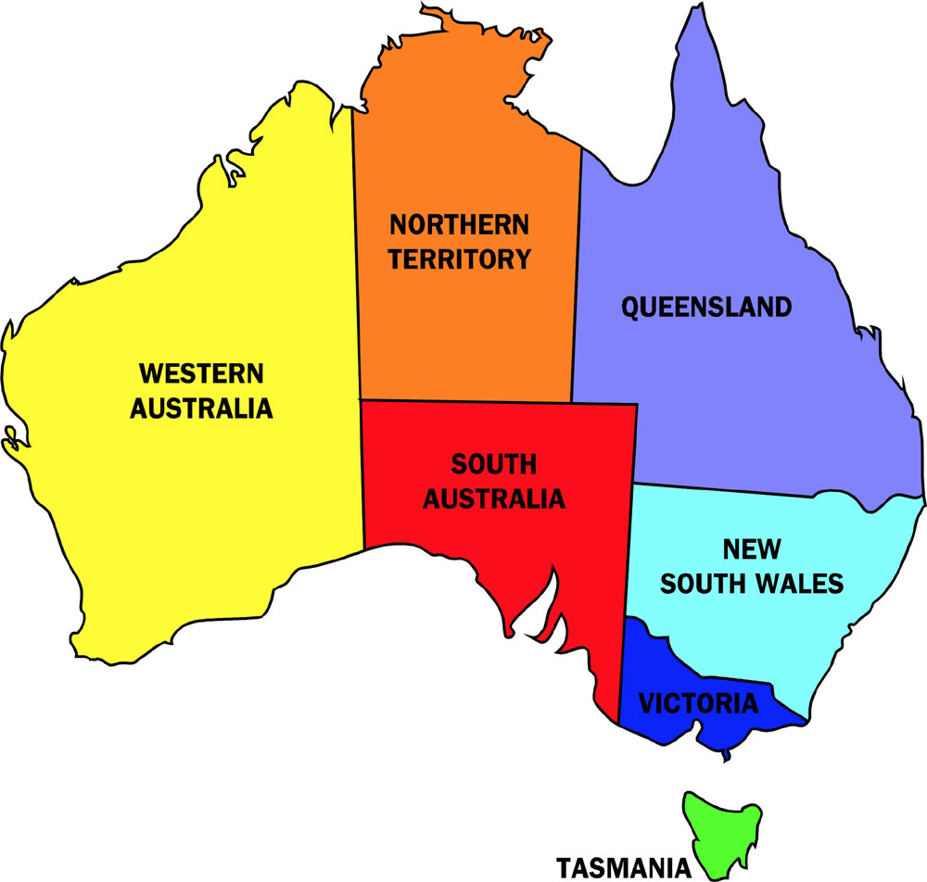
Types of maps
Political maps: Show political boundaries. On a small scale these might be the boundaries between local councils, on a larger scale the boundaries between states and on giant scale the boundaries between countries.
Tourists, students, government etc.

