Slide 1
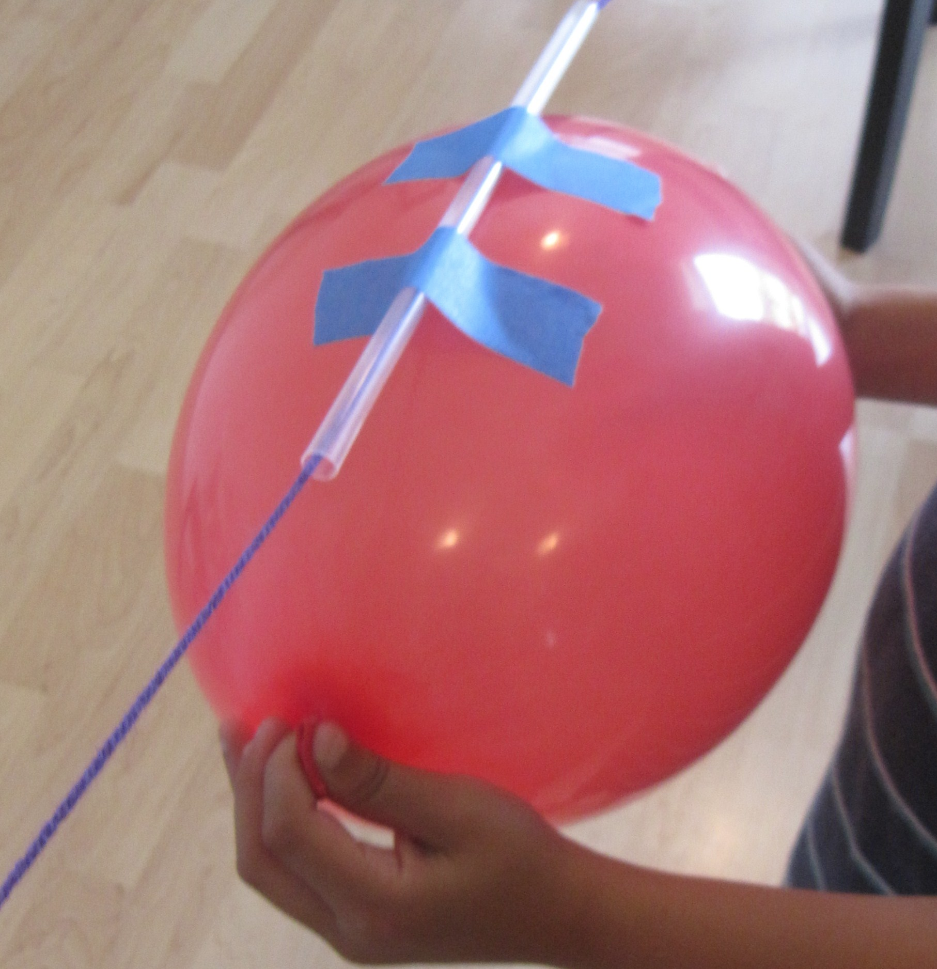
Rocket Balloon Experiment
Aim:
What will happen if a balloon suspended beneath a string has the air released?
Does the amount of air in the balloon affect what happens when the air is released?

Slide 2
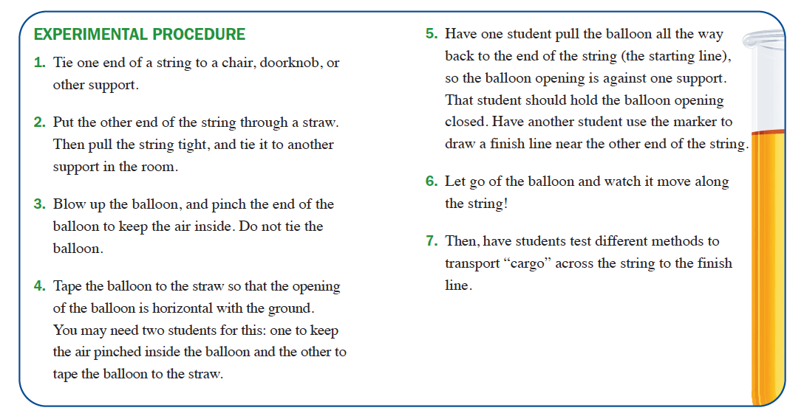
Rocket Balloon Experiment

